Slide 1
The status of the engineer in society and the importance of mobility
Katy Turff
Engineering Council (UK)

Slide 2
Contribution of engineers to society
“Engineering drives social, economic and human development and underpins our knowledge societies and infrastructures. It is a major factor in innovation and indeed the rise and fall of civilizations”
UNESCO Engineering Report, 2010

Slide 3
The need for mobility
“ There has been a significant increase..in plans to recruit from within the EU, with 20% of (UK) employers looking to do so in the next 4-5 years ”
Skills Demand 2014,
Institution of Engineering and Technology

Slide 4
FEANI survey 2013
FEANI National Member | Inbound / of which from EU | Outbound / of which to EU
Germany | 156000 (9.64%)
Netherlands | 5800 | 1000
Ireland | 15% / 9% | 14% / 7.5%
Denmark | 12335 (9.57%) | 2167 / 1045 (1.87%)
Finland |  | 1487(1.7%)/830
France |  | 104.800 (13.1%) /70.000
Sweden | 16000 (8.5%) | 1370 (1%)/869

Slide 5
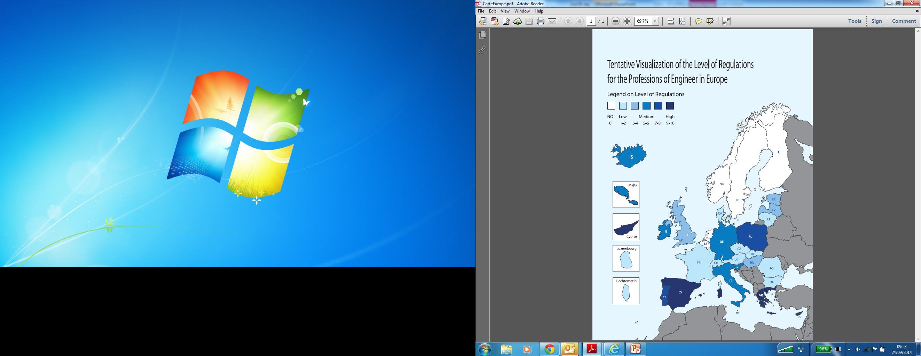
Levels of Regulation

Slide 6
Why Regulate?
Inadequate competition
Fraud, deception and oppressive marketing practices
Imperfect information
Safety
Resolution of disputes and the pursuit of redress
Social objectives
Vulnerable consumers
Raising standards

Slide 7
Good Practice Regulation
Transparency
Accountability
Targeting
Consistency
Proportionality

Slide 8
Professional Qualifications
Academic qualification
Registration based on academic qualification
Competency-based Professional Register
  Independent peer assessment of formal, informal and non-formal learning and work experience
Professional registers usually require a commitment to a code of ethics/conduct, and to maintain competence through CPD

Slide 9
The Engineering Team
Directive | Title
Article 11 (e) | Chartered Engineer (UK) Engenheiro (PT) Ingegnere (IT) Ingeniero (ES)
Article 11 (d) | Associate Engineer (IRE) Engenheiro Técnico (PT) Incorporated Engineer (UK) Ingegnere Iunior(IT) Ingeniero Técnico (ES) Injenor Iunior (IT) Mérnök (HU)
Article 11 (c) | Engineering Technician (IRE, UK) Techniker (DE)

Slide 10
Mobility Tools
EU Directive on Recognition of Professional Qualifications
EUR ING title
FEANI INDEX
EUR-ACE Label
Engineering Card

Slide 11
Public image and engineers
“We’re now 100% dependent on science and engineering for our future for food, medicine, clean water and air”
Dr J Craig Venter,
Global Grand Challenges Summit, 2013

